Slide 1


Modern Control Theory
Lecture No. 11
Conceptualizing the Structure of a Kalman Filter

Slide 2
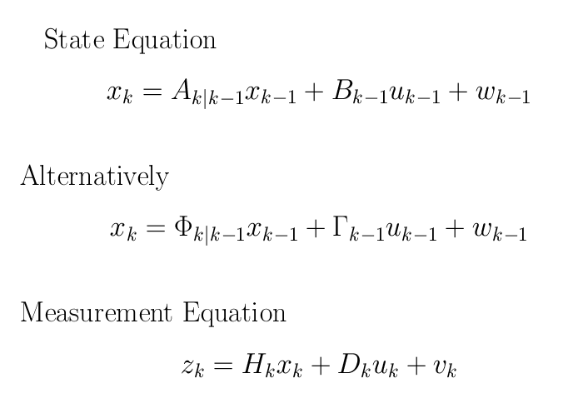
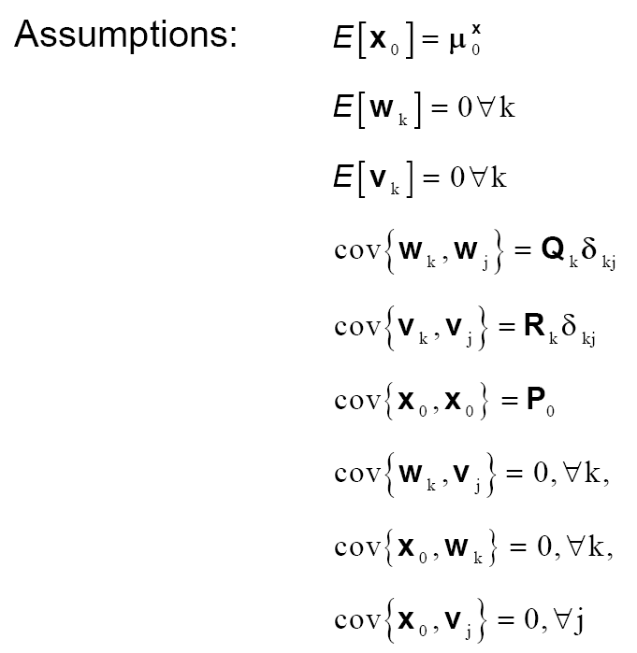
System Dynamics with Forcing Function & Noise
Assumptions

Slide 3
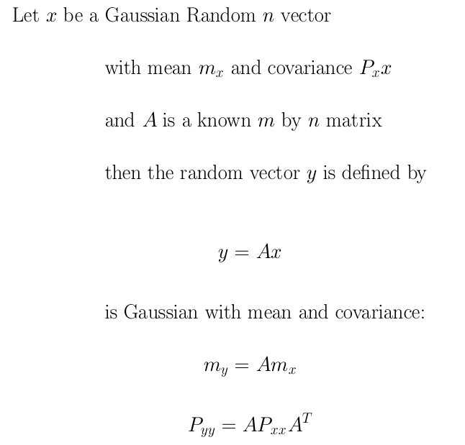
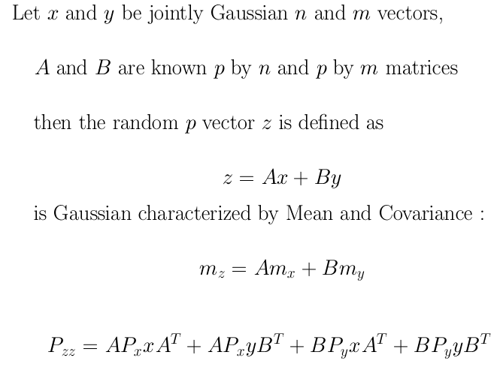
Linear Transformations on a Gaussian Random Variable

Slide 4
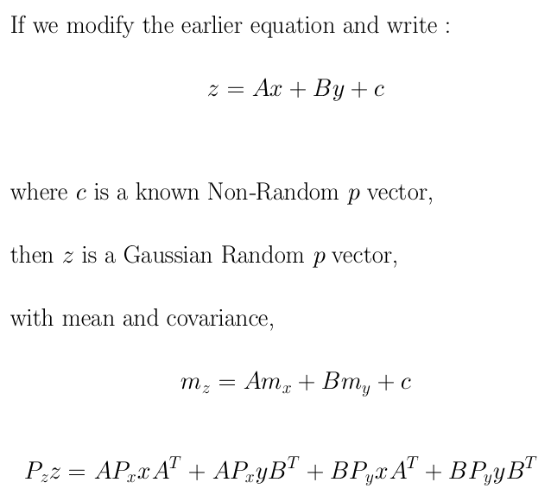

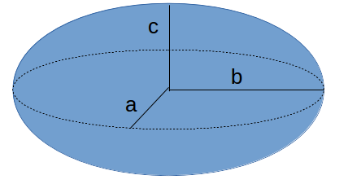
Linear Combinations of Jointly Gaussian Random Variables & Non-Random Vectors are also Gaussian Random Variables
+ Q

Slide 5
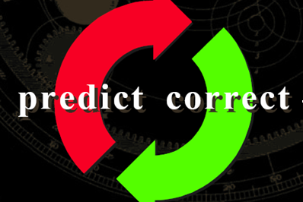
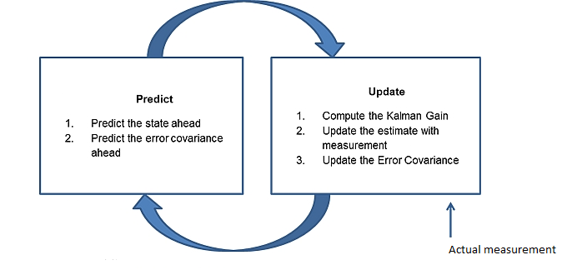

Understanding the Prediction & Update Process/ Steps
Update
Prediction
(k-1)+
(k)-
(k)+
k-1
k
z(k-1)
z(k)

Slide 6
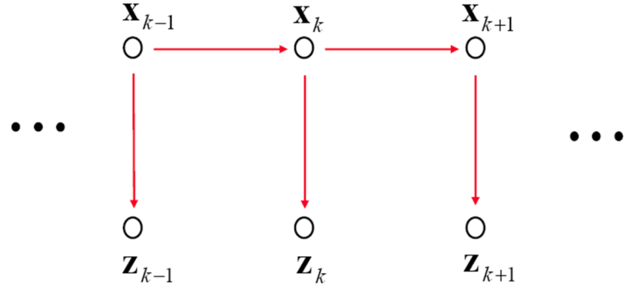
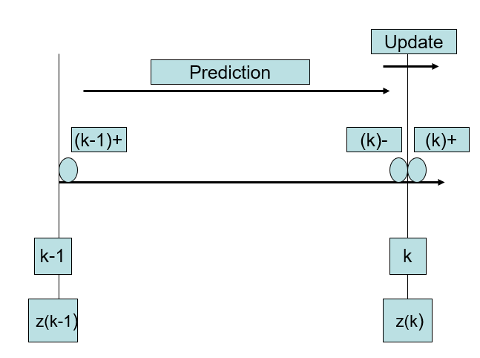
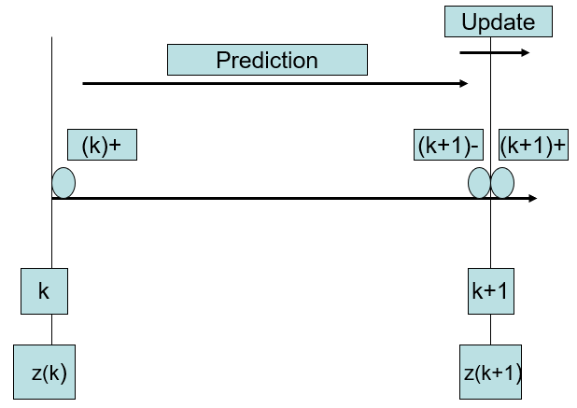
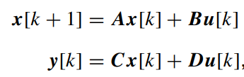

Prediction & Update
k-1
k
k+1
+ Q
+ Q
z(k-1)
z(k)
z(k+1)

Slide 7

Prediction & Update

Slide 8
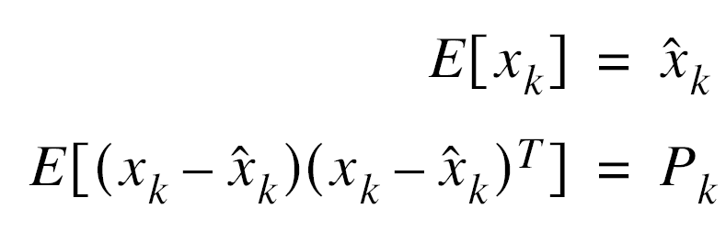
An Optimal State Estimator
Estimating the State
Minimizes the Error
Obtaining the Mean & Covariance

